Slide 1




Contributing to Psi4Education
PsiCon ’20, All of Our “Home Offices”
Dom Sirianni | Parish Lab @ UR
@DrDomSirianni
@dsirianni
sirianni.dom@gmail.com

Slide 2
Outline
Organization of Psi4Education Materials
How to access instructor materials
Contributing to Psi4Education
Discussion on PRs, issues
Content: Contribution demo
Getting in touch

Slide 3
Organization Structure

Slide 4

Resources Available
https://psicode.netlify.app/posts/psi4education/

Slide 5
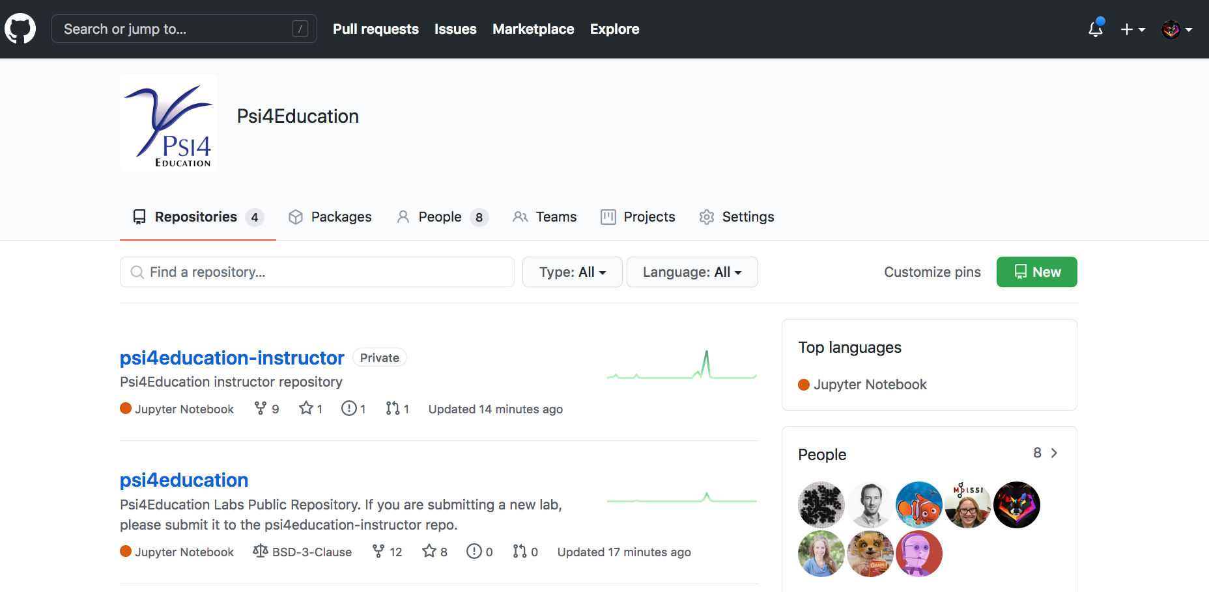
Psi4Education on GitHub
https://github.com/Psi4Education

Slide 6
Student vs. Instructor Repositories
P4EDU/psi4education
P4EDU/psi4education-instructor
Public-facing
Includes all materials necessary for students
ChemCompute/Jupyter Hub integration
Private, access for registered instructors
Includes student and instructor materials
Answer keys
Lesson resources & plans
LaTeX & Jupyter source for collaboration

Slide 7
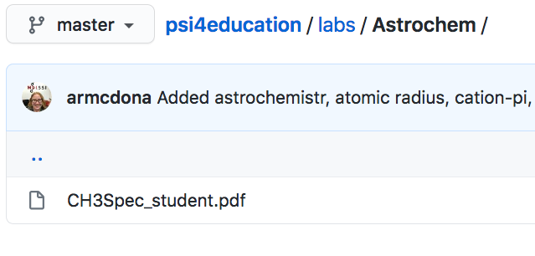
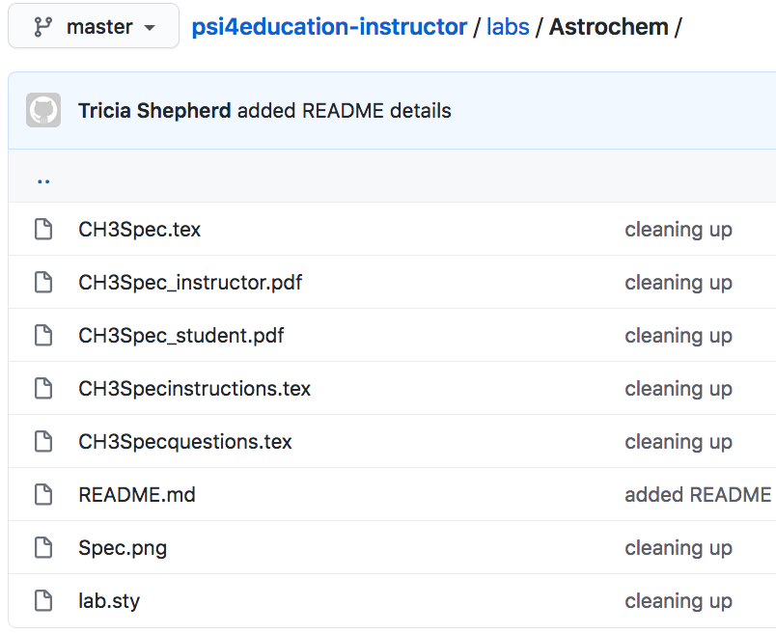

Student vs. Instructor Repositories
P4EDU/psi4education
P4EDU/psi4education-instructor
Notes:
Propynylidynium

Slide 8
Accessing Instructor Materials

Slide 9
Accessing Instructor Materials
Register as an instructor by emailing Prof. McDonald or I, with:
Institutional affiliation
GitHub username
Description of course(s) in which you plan to use materials
Once registered, you’ll be added to Psi4Education organization so you can access P4EDU/psi4education-instructors repository

Slide 10
https://github.com/Psi4Education

Slide 11
Instructor Access
P4EDU/psi4education
P4EDU/psi4education-instructor
Notes:
Propynylidynium

Slide 12
Contributing to Psi4Education

Slide 13
Contributing to Psi4Education
Two major ways to contribute to our community:
Getting involved in community discussions on GitHub (issues/PRs)

Slide 14
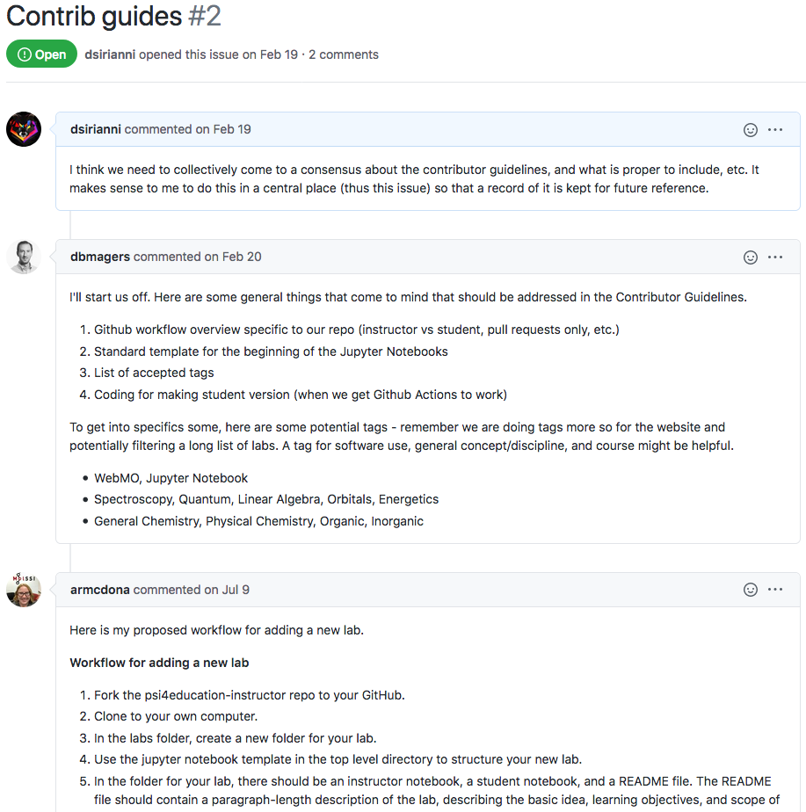
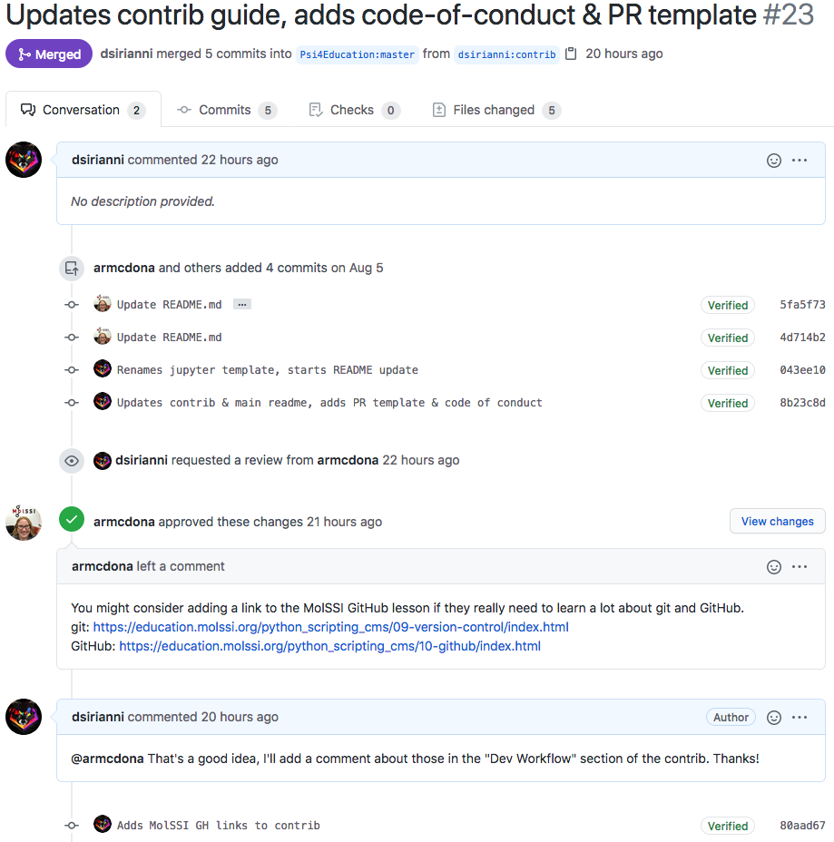
Discussions on Issues & Pull-Requests

Slide 15
Contributing to Psi4Education
Two major ways to contribute to our community:
Getting involved in community discussions on GitHub (issues/PRs)
Contributing content directly to Psi4Education
Minor fixes or improvements of existing resources
Creating completely new resources
We also provide extensive contributor guidelines and an inclusive code-of-conduct for Psi4EDU members & contributors

Slide 16
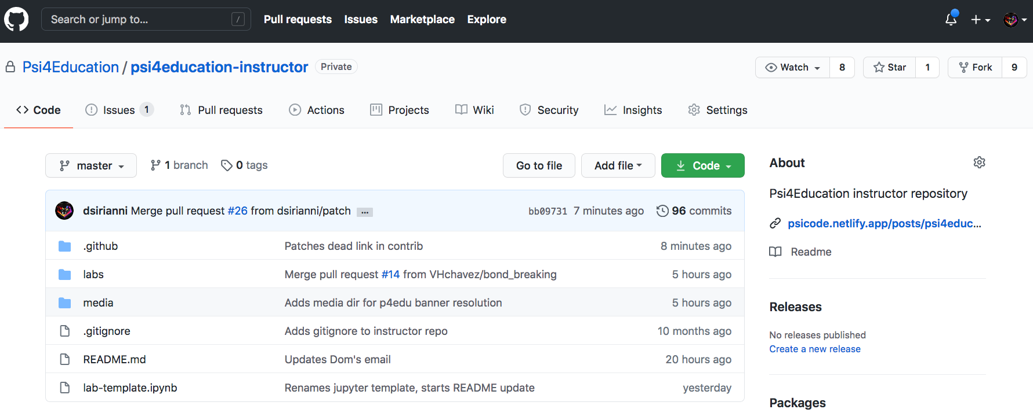
Contribution Demo

Slide 17
Getting in Touch

Slide 18
Getting In Touch
Prof. Ashley Ringer McDonald, CalPoly
armcdona@calpoly.edu
Dr. Dom Sirianni, U. Richmond
sirianni.dom@gmail.com
dsiriann@richmond.edu

Slide 19

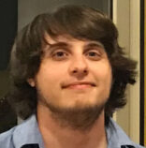
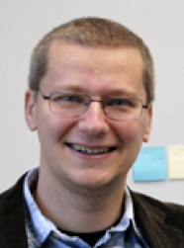
Acknowledgements

